Slide 2
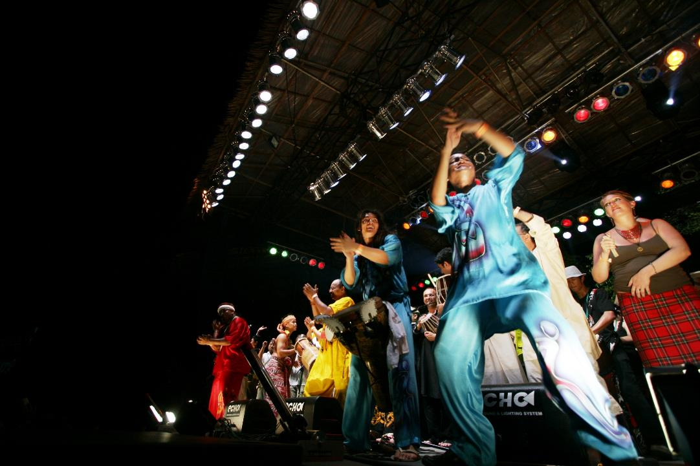

Slide 3
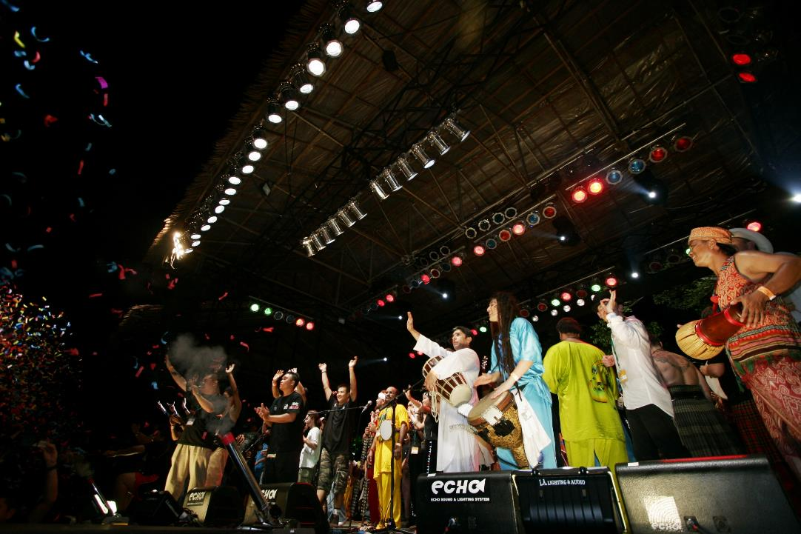

Slide 4
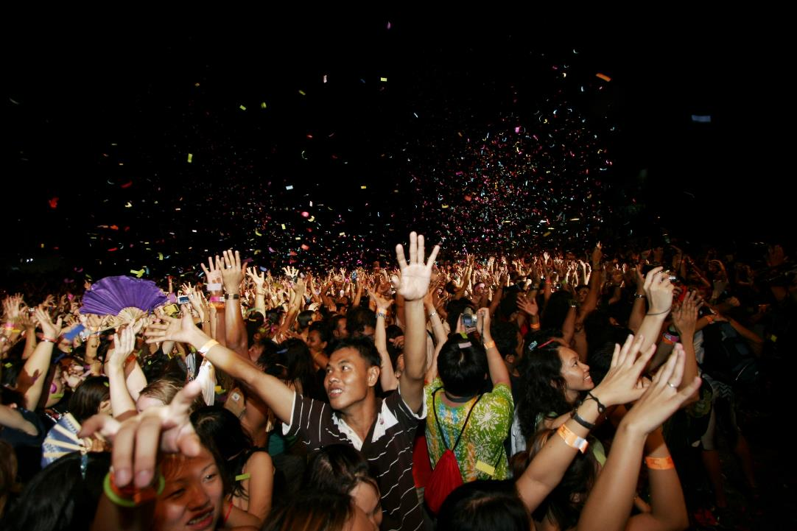

Slide 5
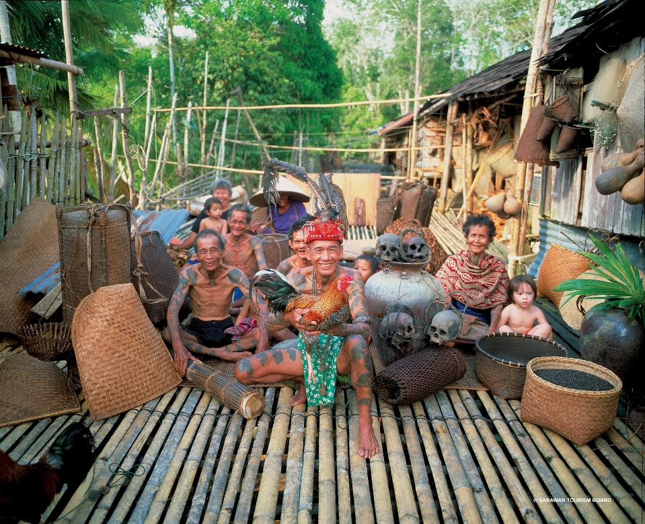

Slide 6
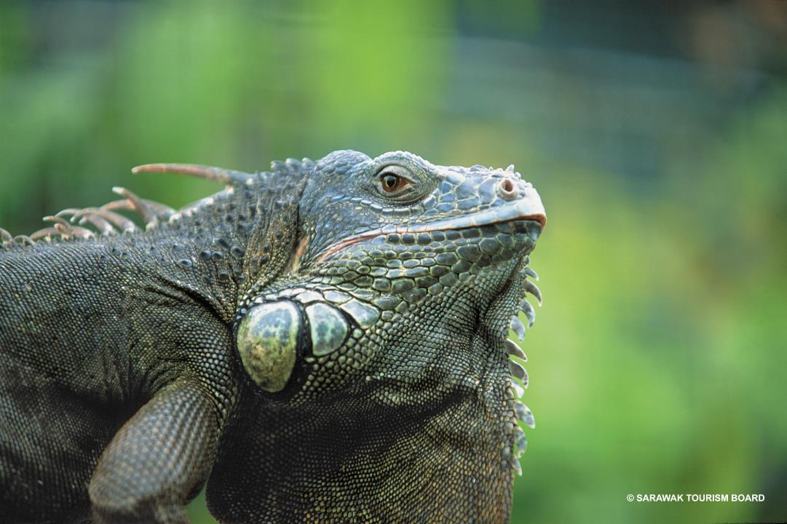

Slide 7
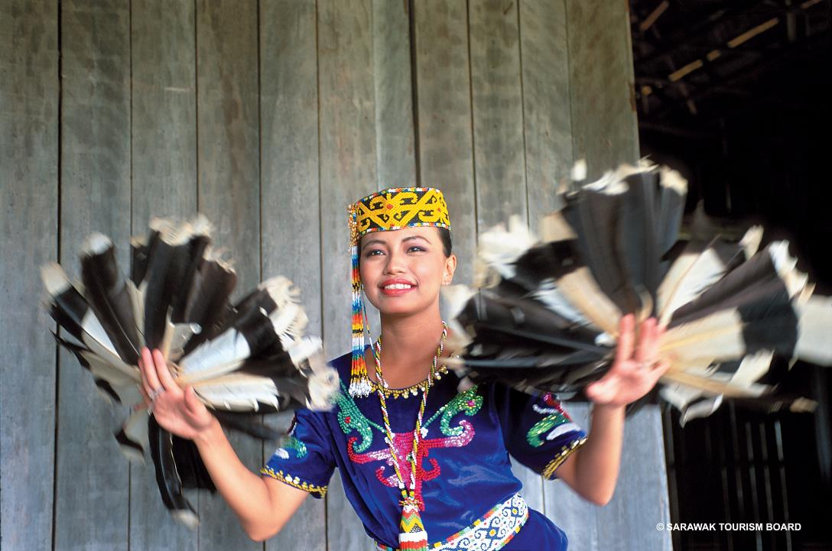

Slide 8
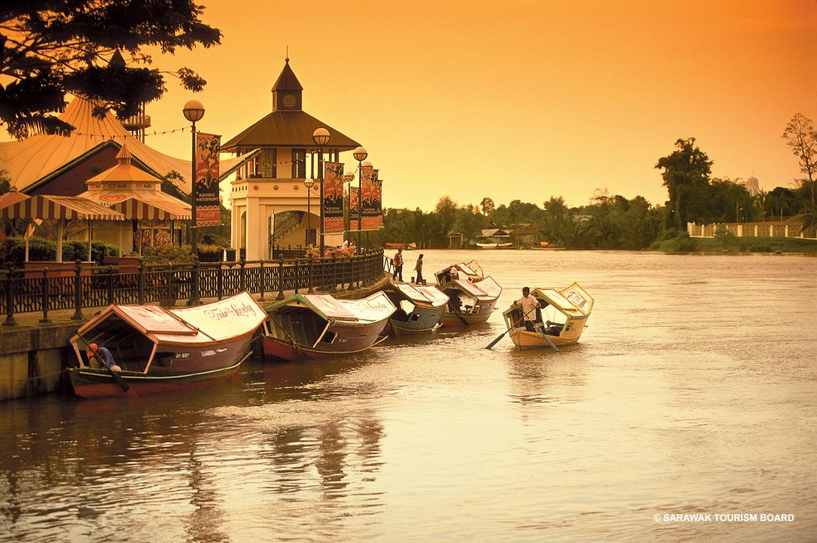

Slide 9
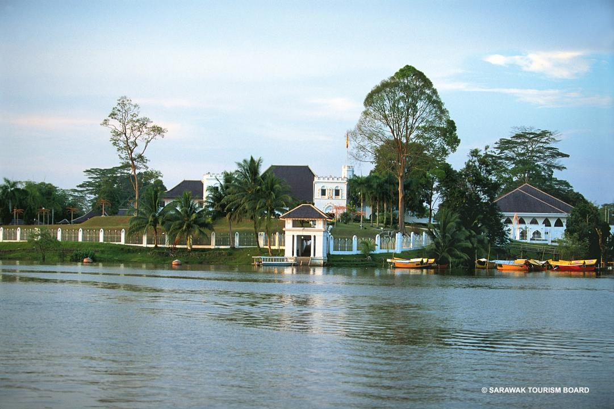

Slide 10
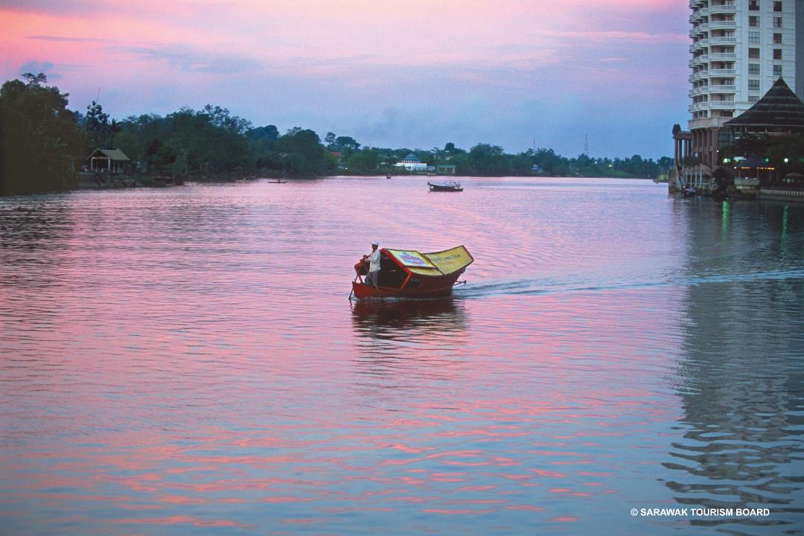

Slide 11
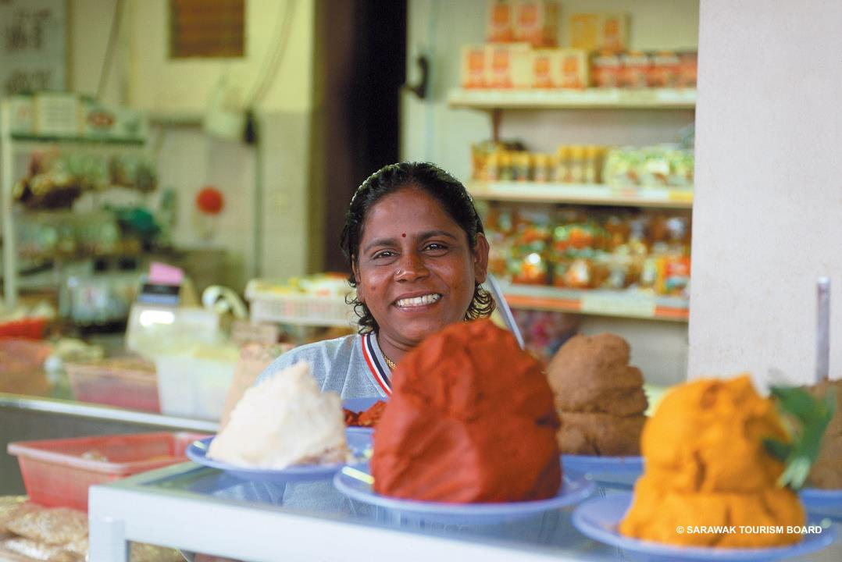

Slide 12
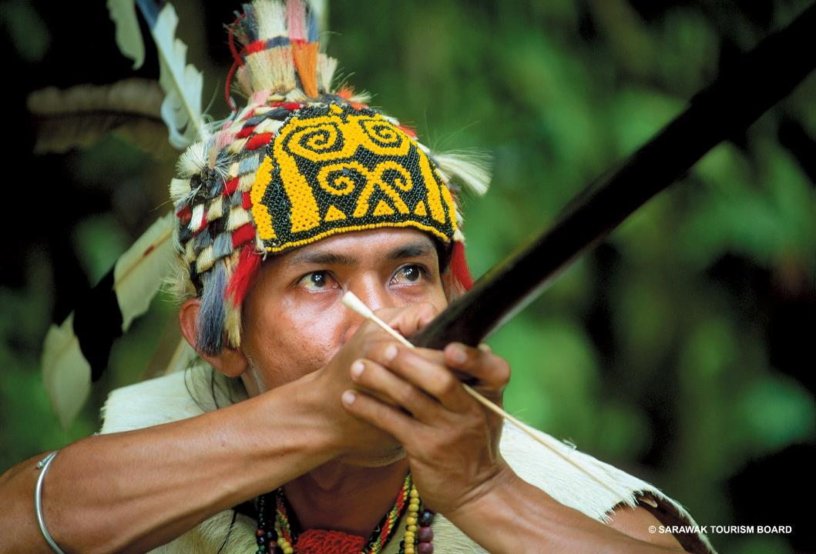

Slide 13
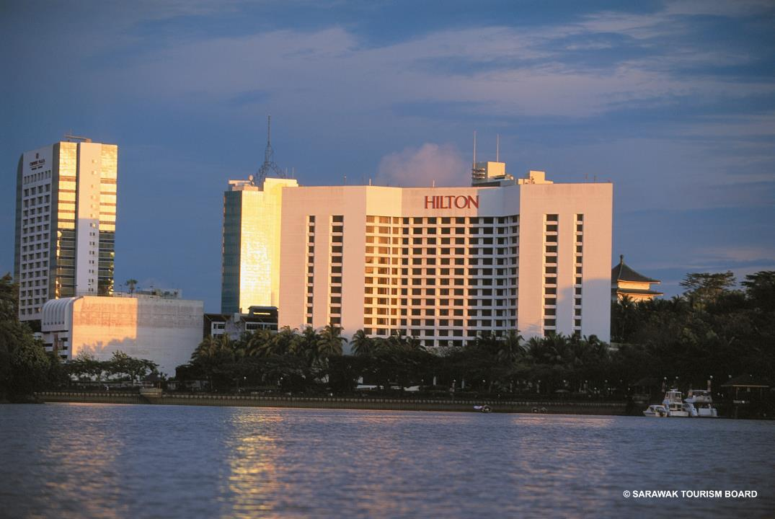

Slide 14
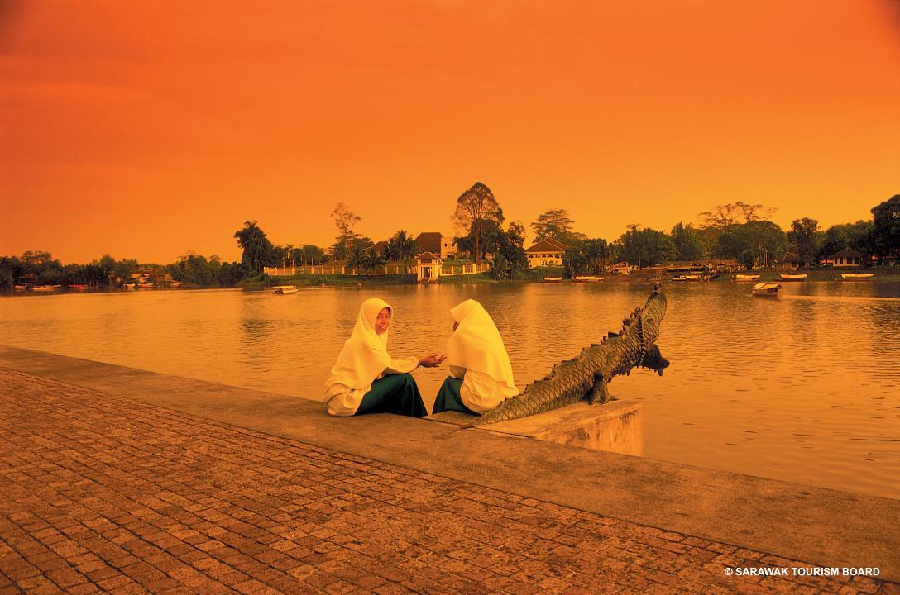

Slide 15
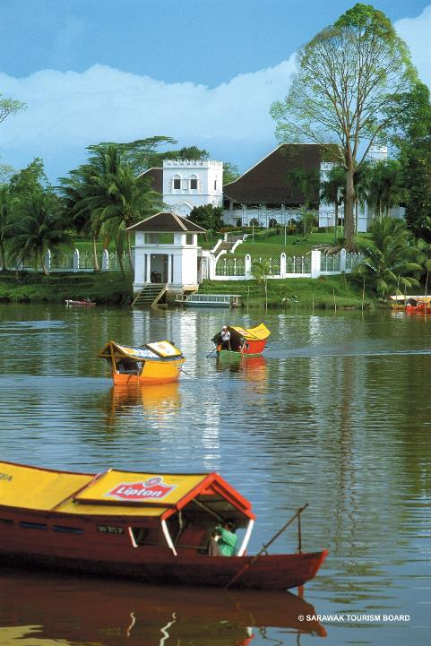
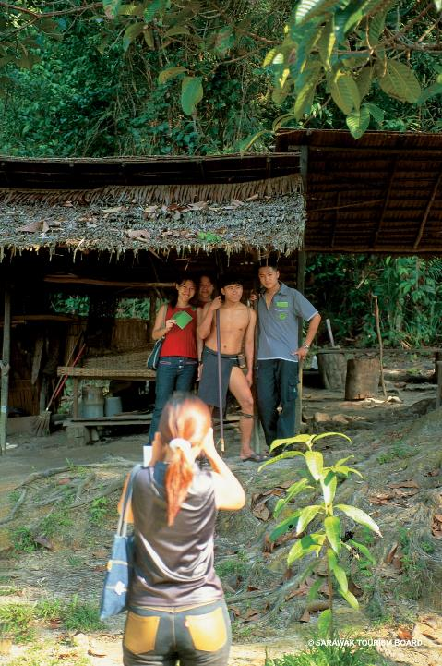

Slide 16
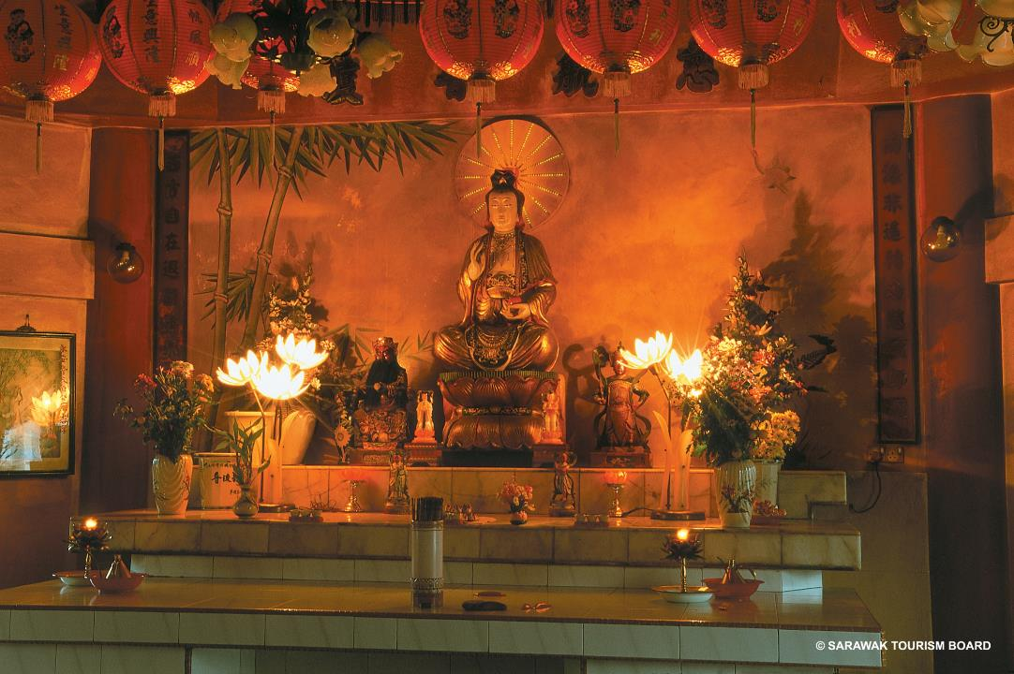

Slide 17
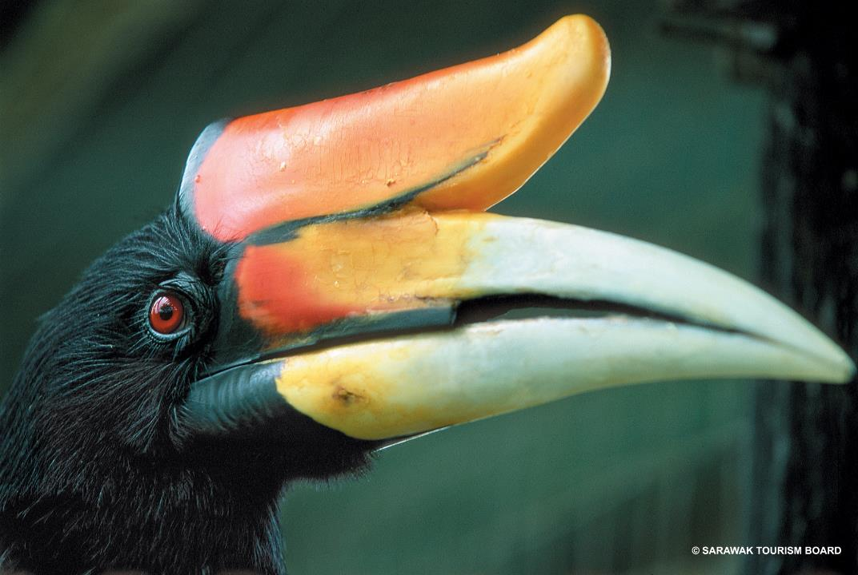

Slide 18


Slide 19
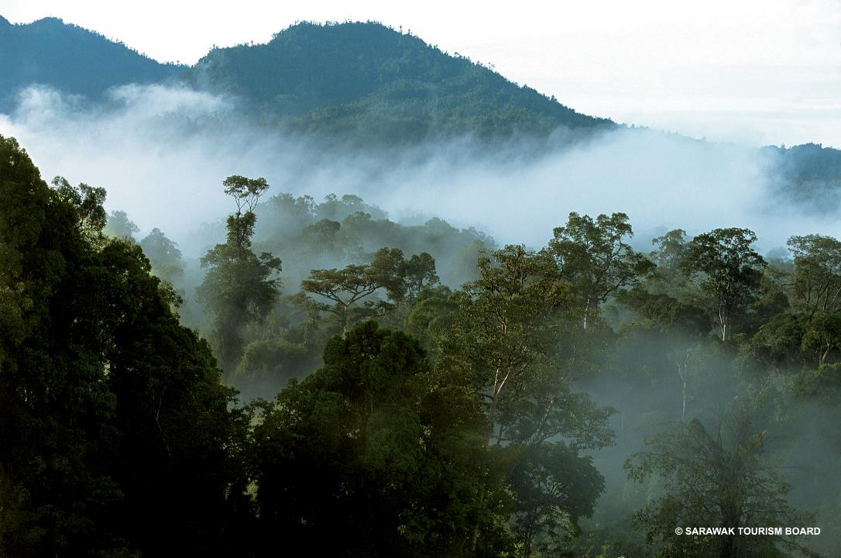

Slide 20
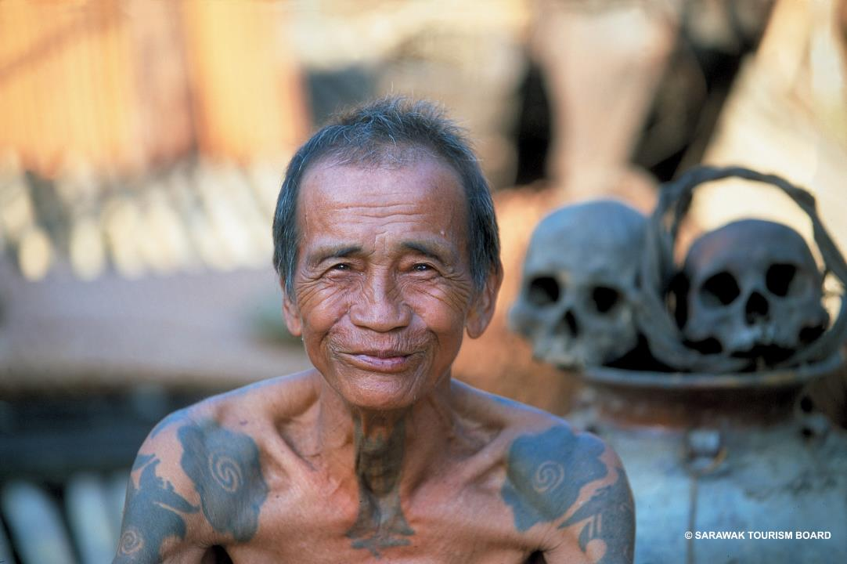

Slide 21
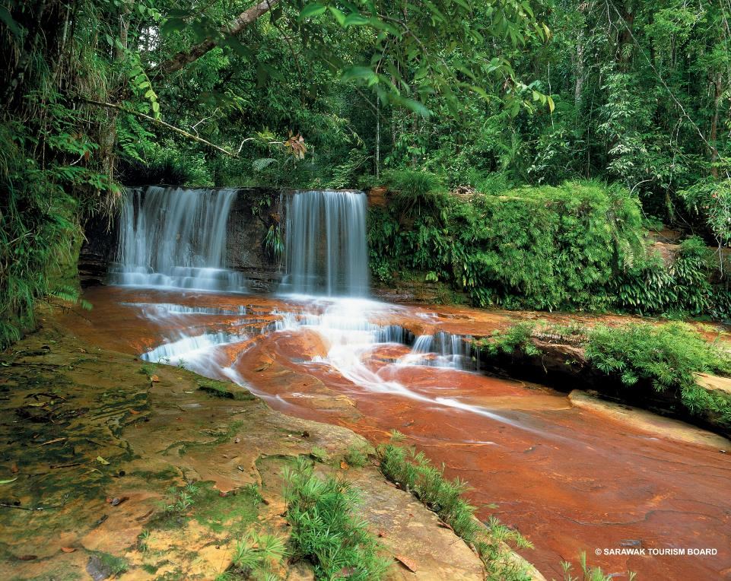

Slide 22
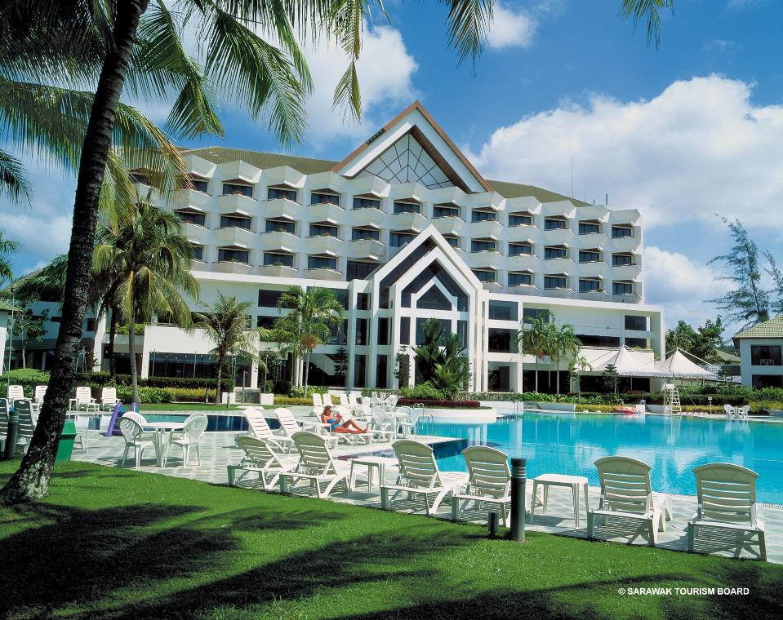

Slide 23
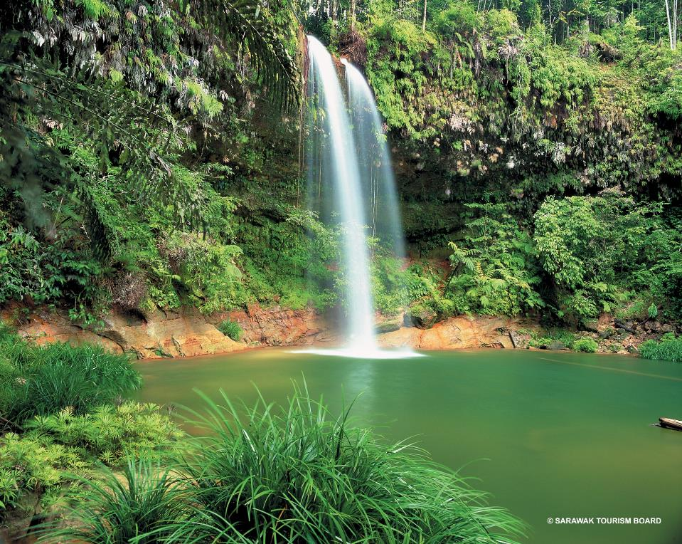

Slide 24
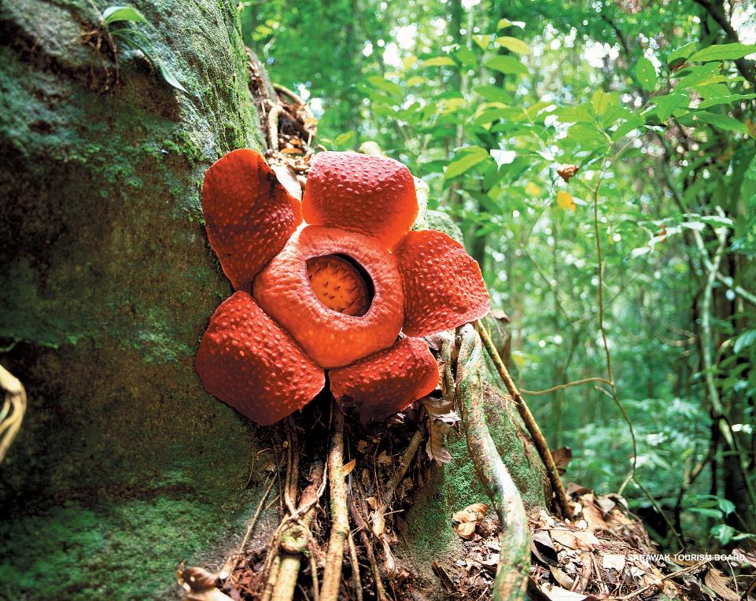

Slide 25
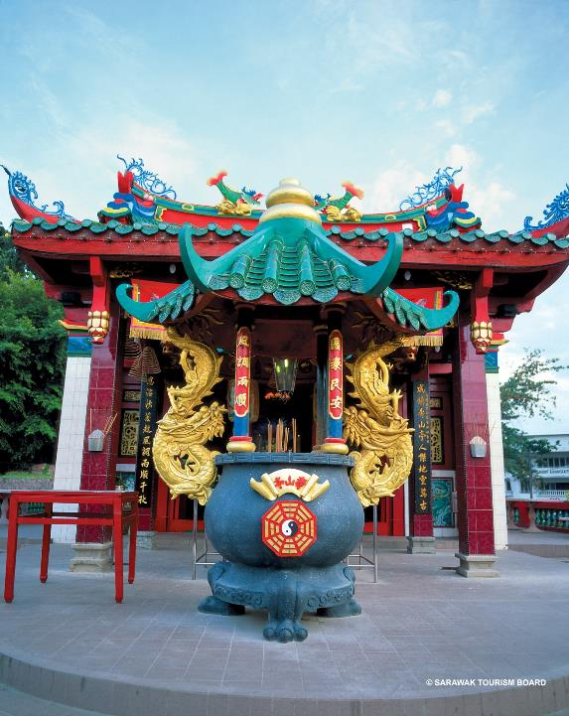

Slide 26
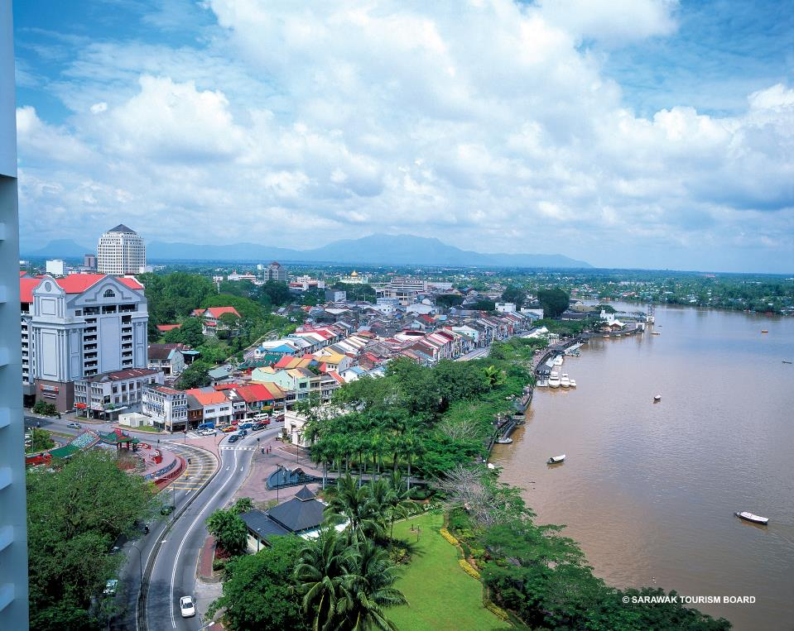

Slide 27
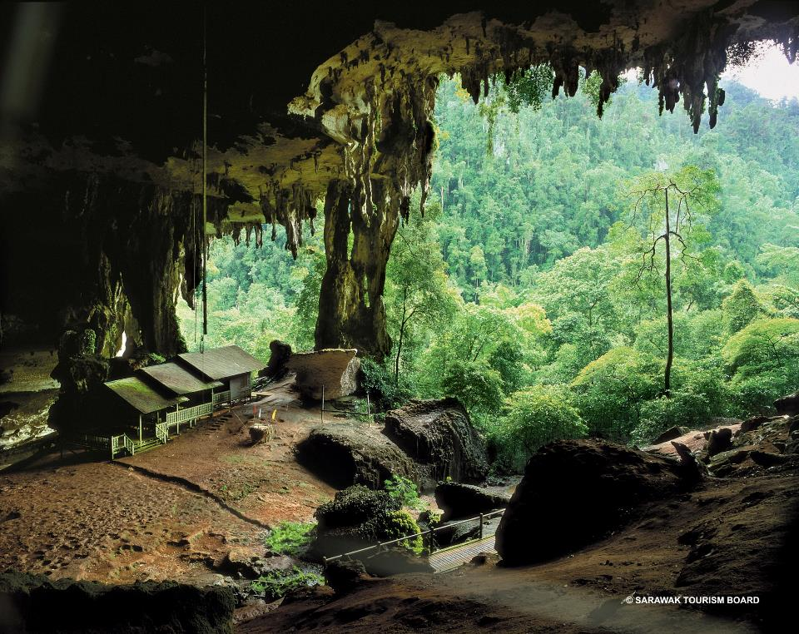

Slide 28
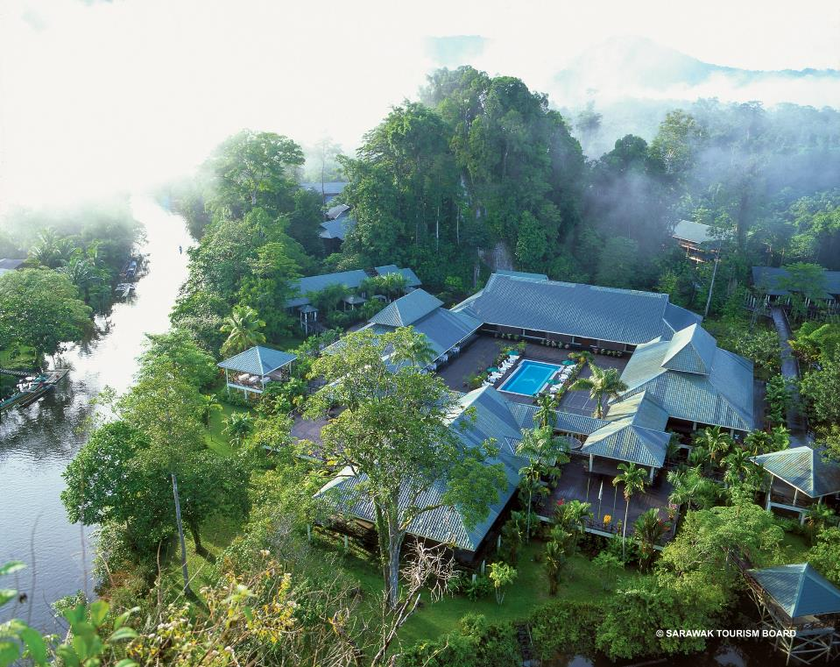

Slide 29
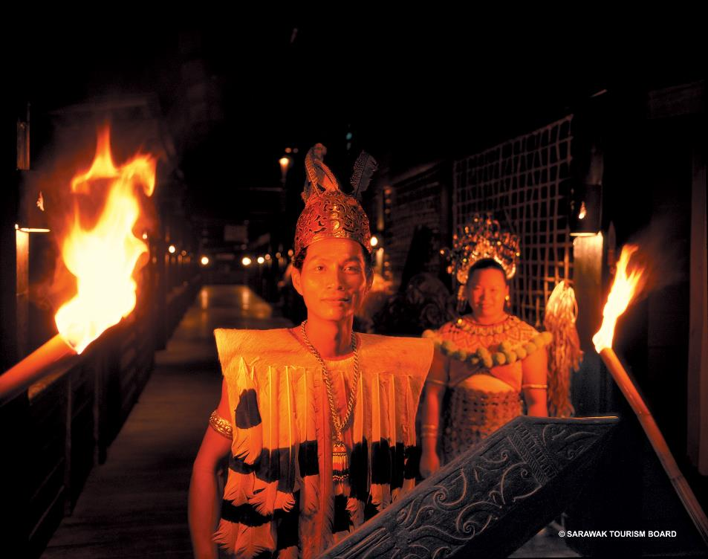

Slide 30
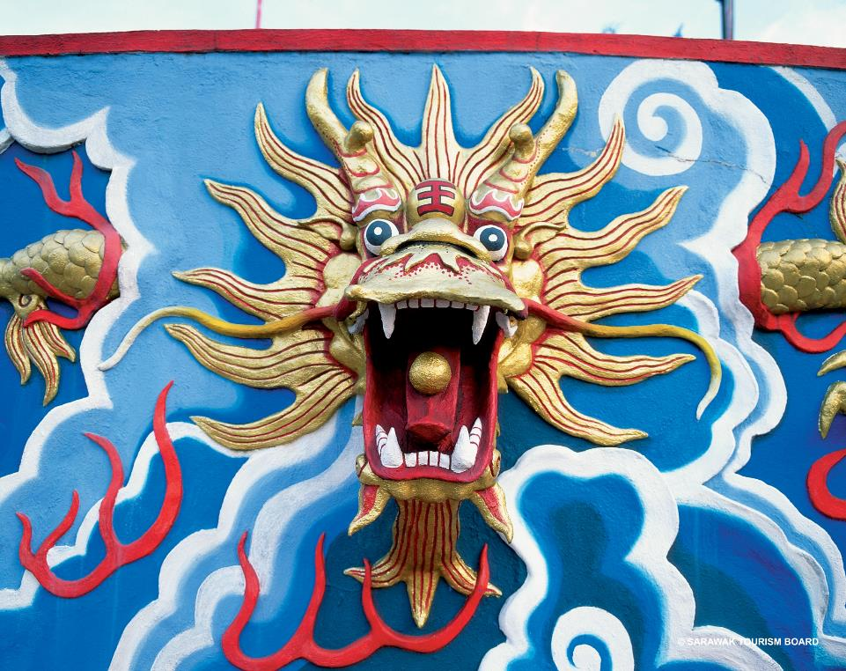

Slide 31
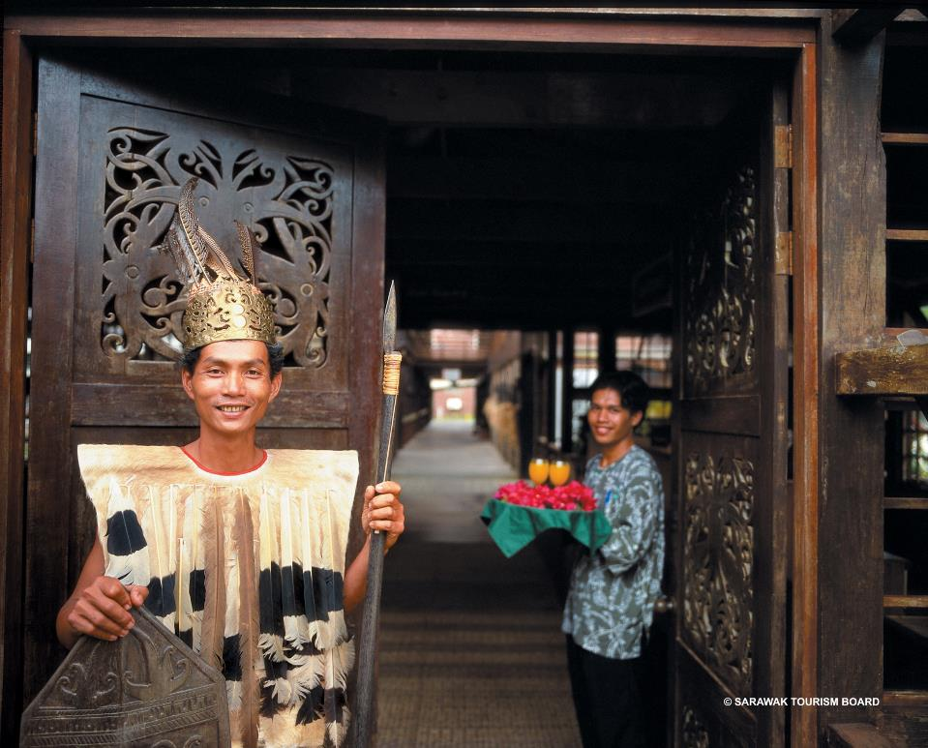

Slide 32
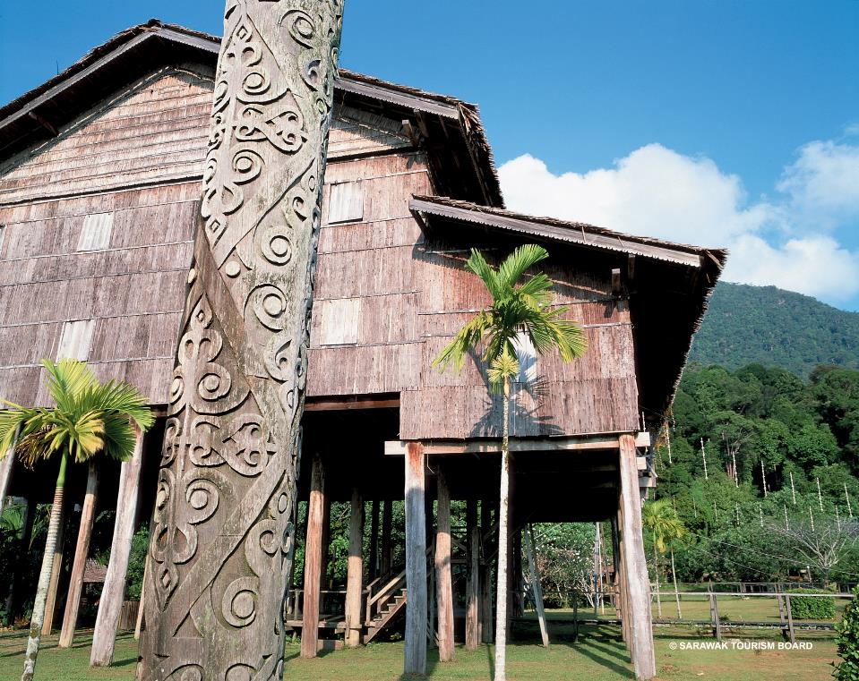

Slide 33
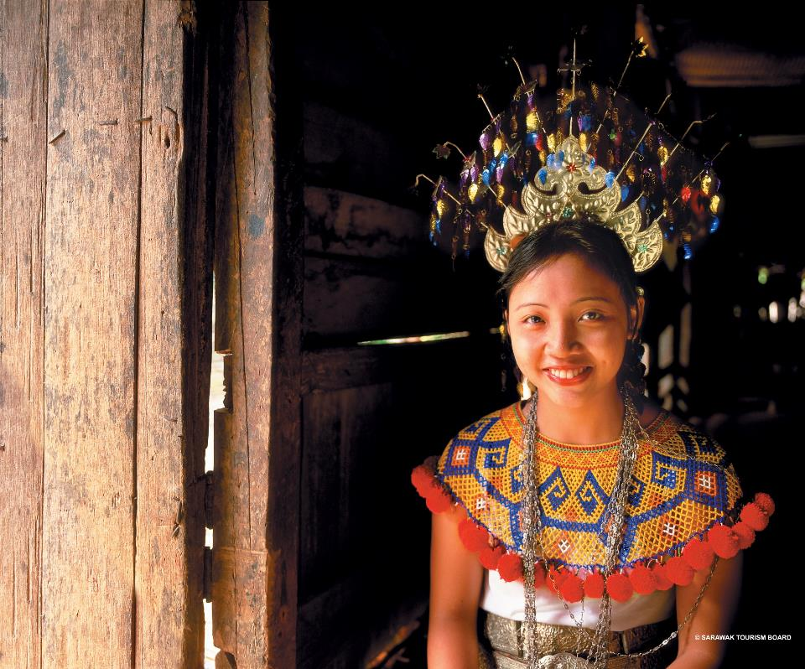

Slide 34
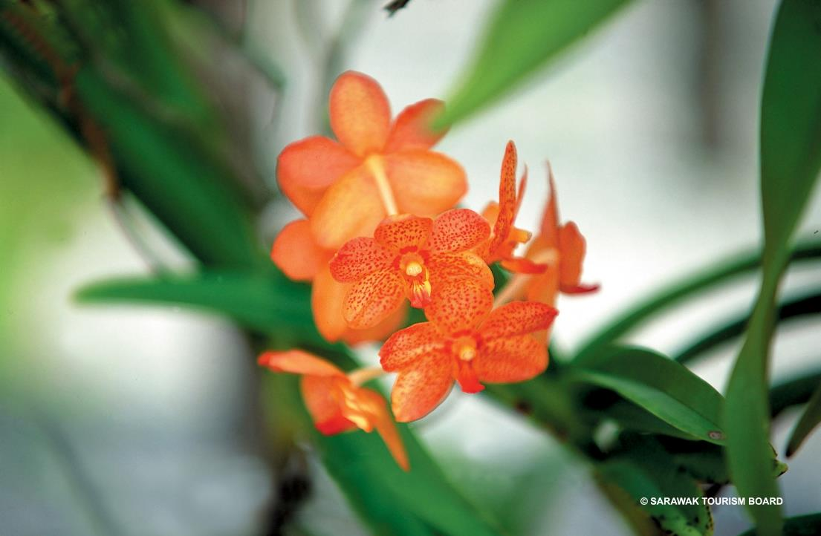

Slide 35
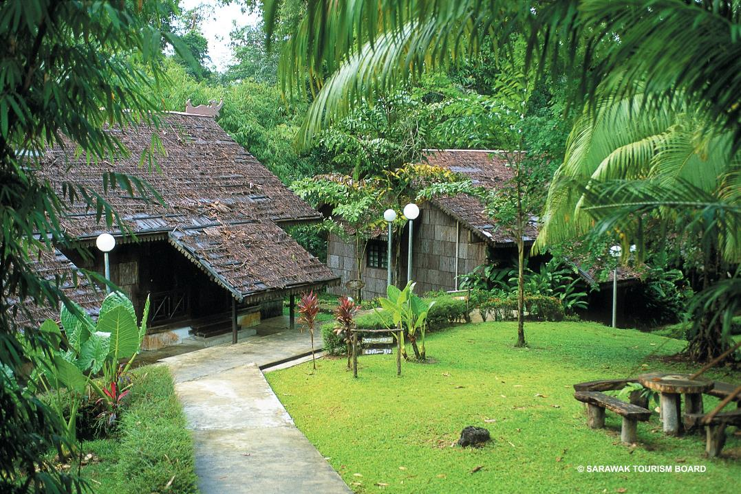

Slide 36
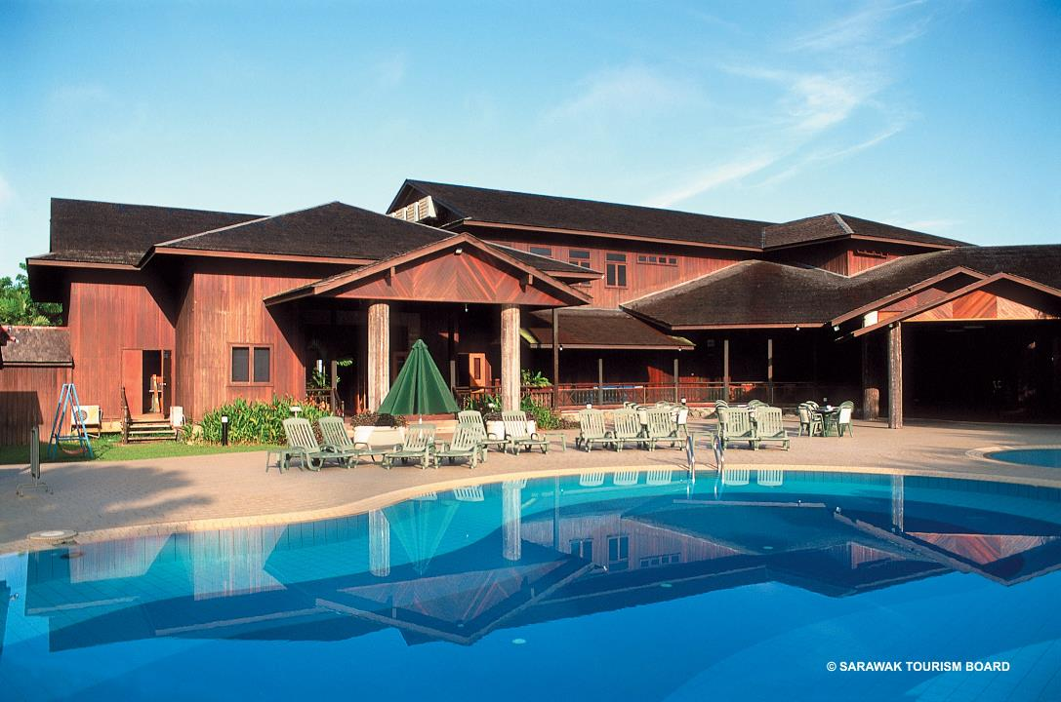

Slide 37
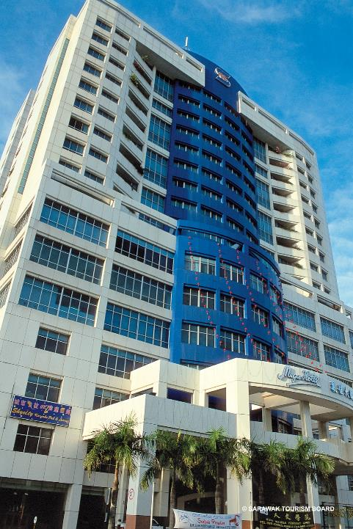
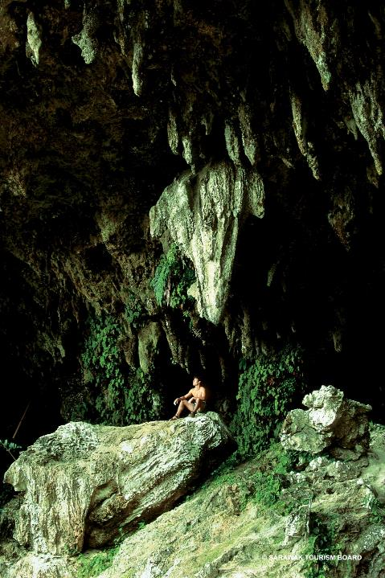

Slide 38
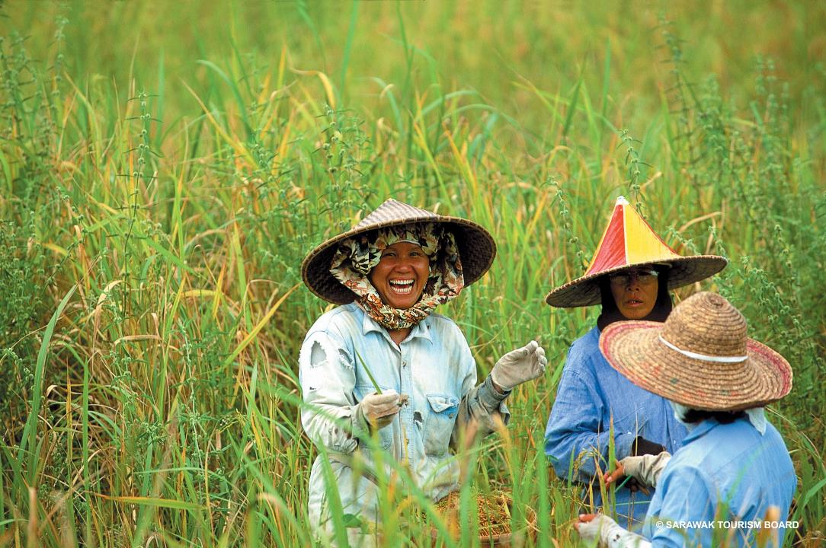

Slide 39
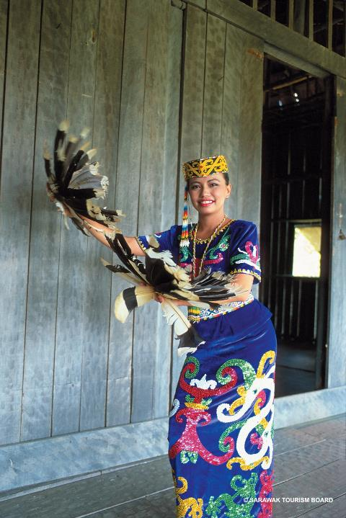
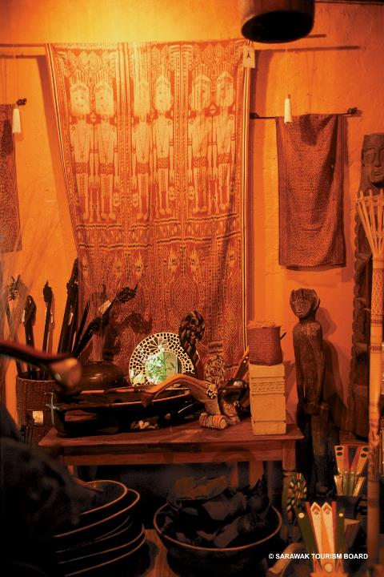

Slide 40
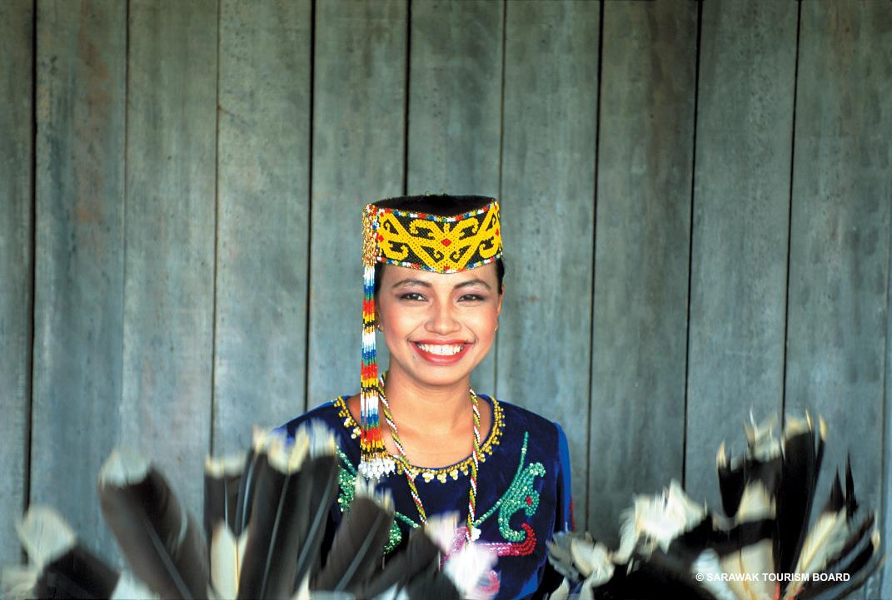

Slide 41
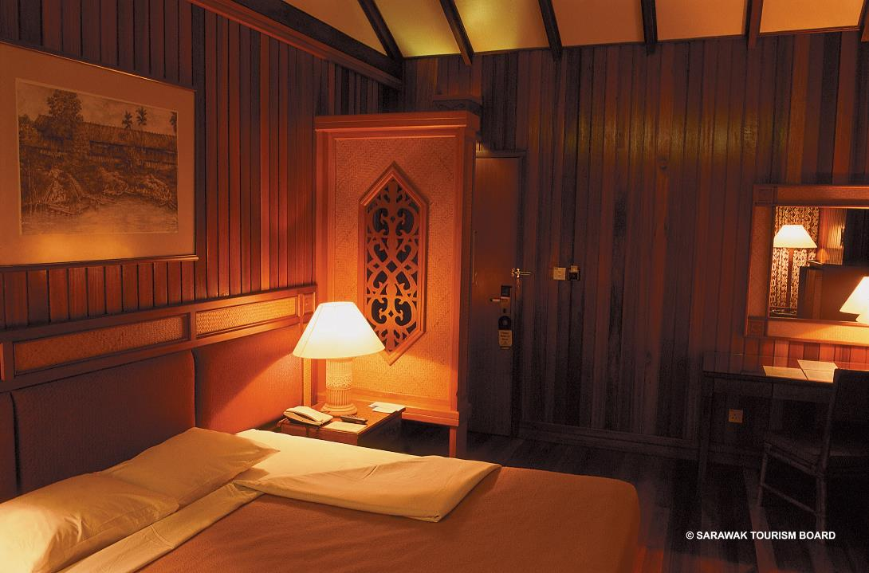

Slide 42
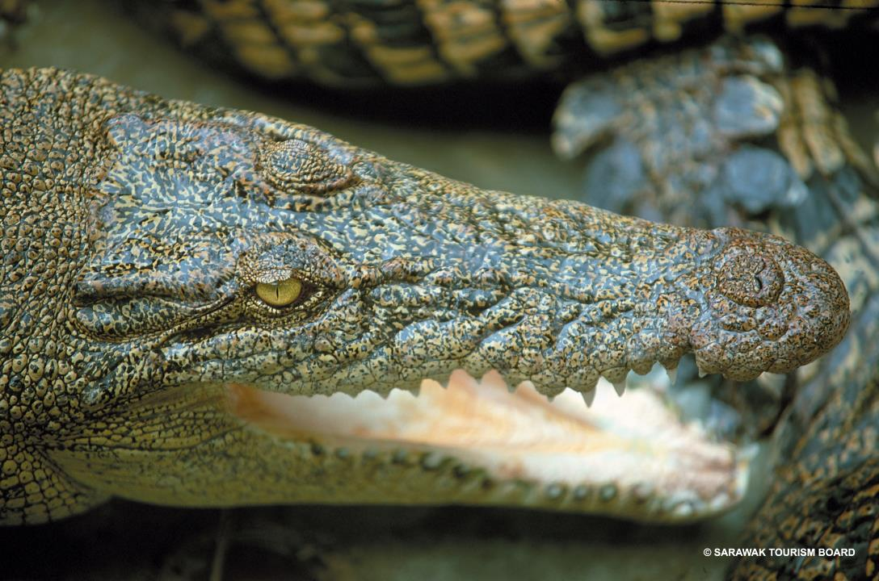

Slide 43
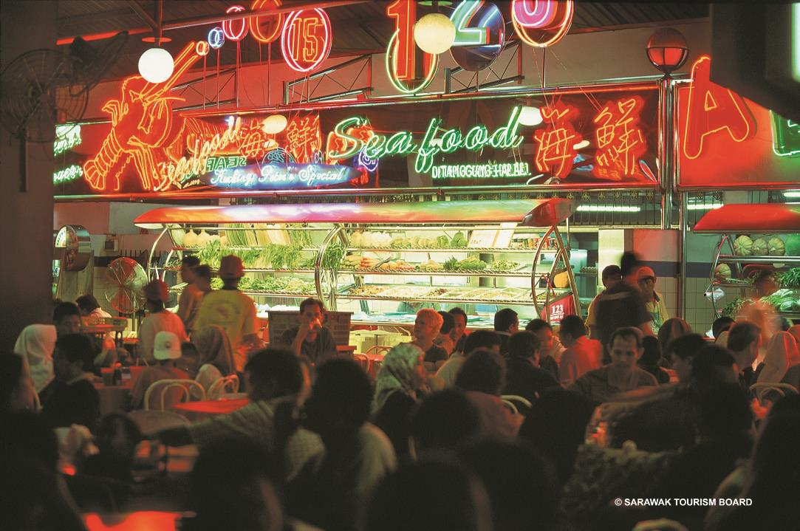

Slide 44
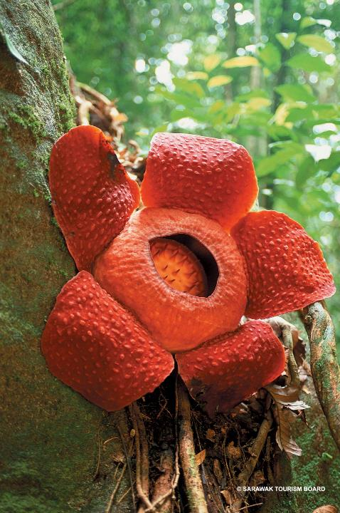
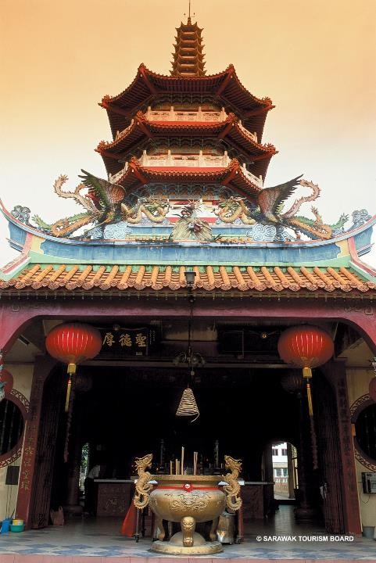

Slide 45
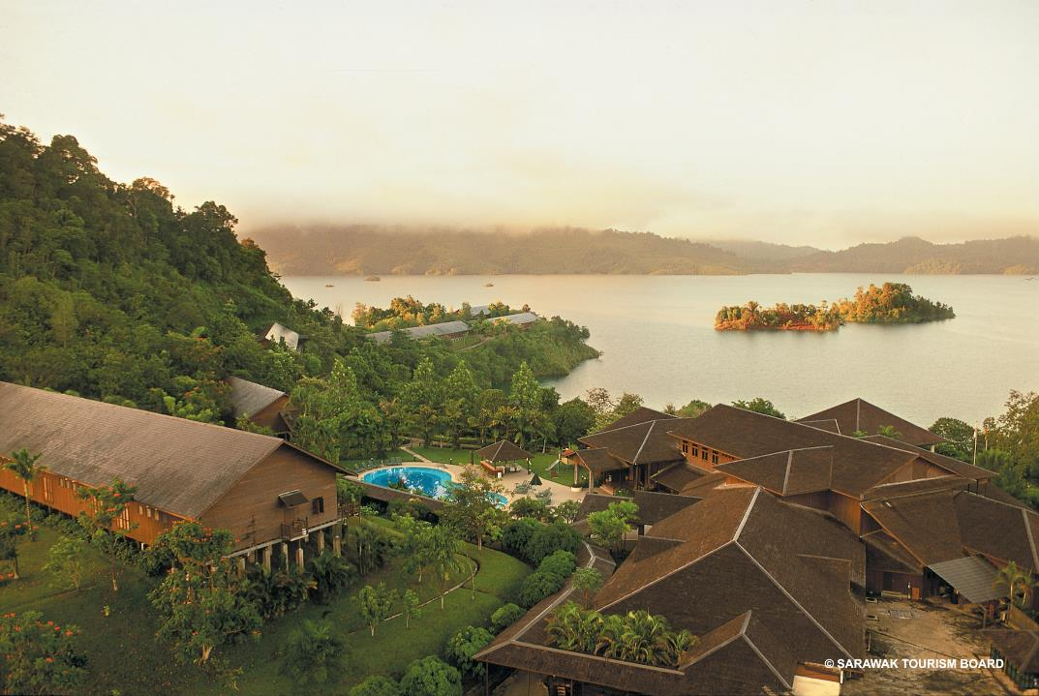

Slide 46
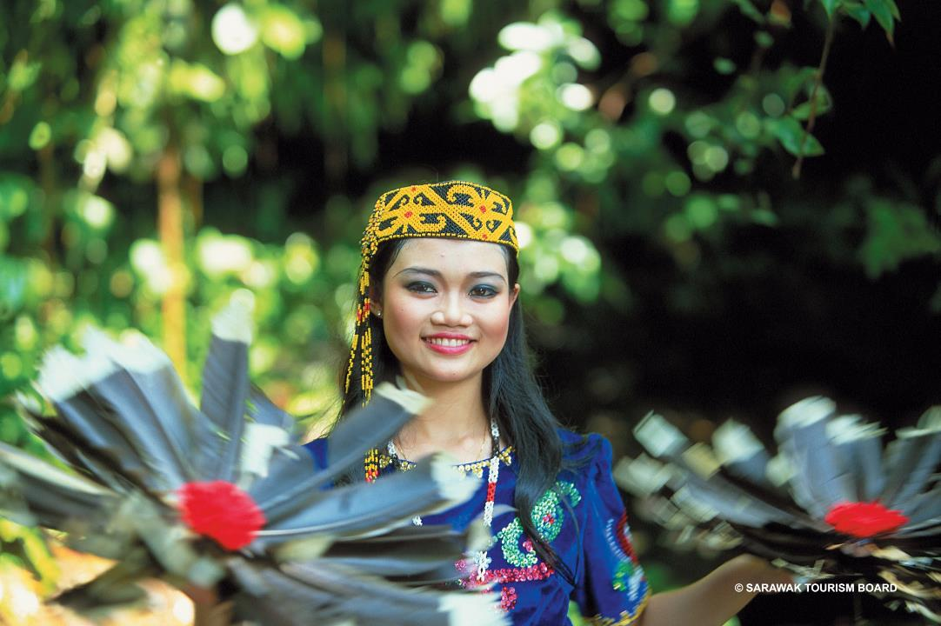

Slide 47
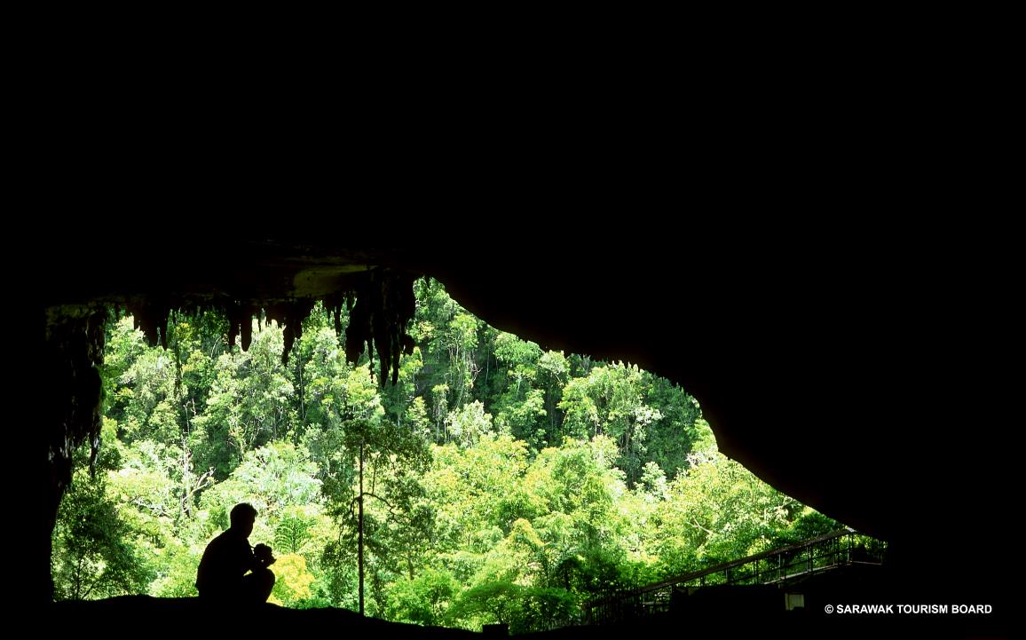

Slide 48
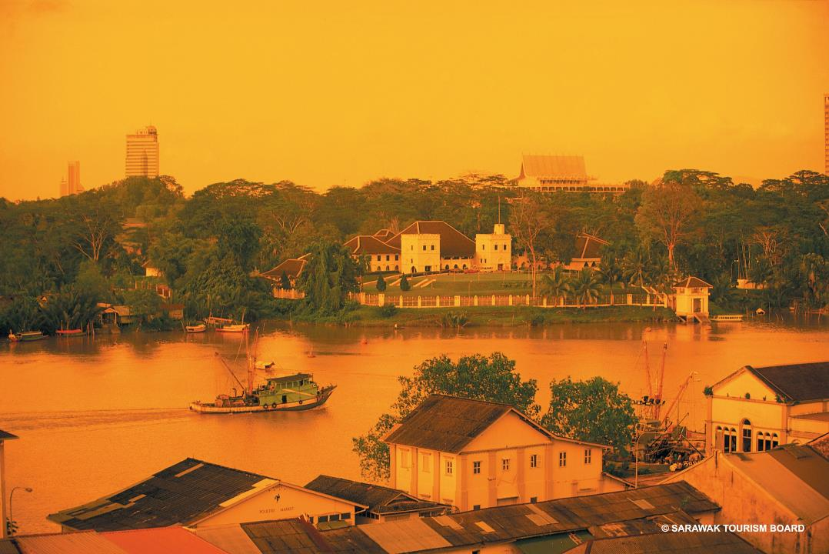

Slide 49



Slide 50


Slide 51



Slide 52


Slide 53


Slide 54


Slide 55


Slide 56


Slide 57


Slide 58


Slide 59


Slide 60


Slide 61


Slide 62


Slide 63


Slide 64


Slide 65


Slide 66


Slide 67


Slide 68


Slide 69



Slide 70


Slide 71


Slide 72


Slide 73


Slide 74


Slide 75


Slide 76


Slide 77


Slide 78


Slide 79


Slide 80


Slide 81


Slide 82


Slide 83


Slide 84


Slide 85


Slide 86


Slide 87



Slide 88


Slide 89


Slide 90


Slide 91


Slide 92


Slide 93



Slide 94


Slide 95


Slide 96


Slide 97


Slide 98


Slide 99


Slide 100


Slide 101



Slide 102


Slide 103


Slide 104


Slide 105


Slide 106


Slide 107


Slide 108


Slide 109


Slide 110


Slide 111


Slide 112


Slide 113


Slide 114


Slide 115


Slide 116


Slide 117


Slide 118


Slide 119


Slide 120


Slide 121


Slide 122


Slide 123
ASA
2007-2013, 2016

Slide 124
Anak Sarawak 2007 - Oscar Night

Slide 125


Slide 126


Slide 127
Anak Sarawak 2008 - Casino Royale

Slide 128


Slide 129


Slide 130
anak sarawak 2009 - Phantom of the opera

Slide 131


Slide 132


Slide 133
Aanak Sarawak 2010 egyptian night

Slide 134


Slide 135
anak sarawak
2011 - rainforest magic- homecoming warriors

Slide 136


Slide 137


Slide 138
anak sarawak 2012

Slide 139


Slide 140


Slide 141
anak sarawak 2013 - the Bidayuh Feast

Slide 142


Slide 143


Slide 144
anak sarawak 2016 - Business events revolution

Slide 145


Slide 146


Slide 147
Business
event venues

Slide 148
Borneo Convention Centre Kuching

Slide 149


Slide 150
old courthouse

Slide 151


Slide 152
Citadines
uplands
kuching

Slide 153


Slide 154
grand margherita
hotel

Slide 155


Slide 156
hilton kuching hotel

Slide 157


Slide 158
Merdeka Palace hotel

Slide 159


Slide 160
Pullman kuching hotel

Slide 161


Slide 162
Riverside majestic hotel

Slide 163


Slide 164
Waterfront Hotel Kuching

Slide 165


Slide 166
CSR

Slide 167
Heart to
Heart with Orangutans

Slide 168


Slide 169
Heart treasures

Slide 170


Slide 171
Incentive
Tours

Slide 172
Business Events Forum

Slide 173


Slide 174
Kampung
Danu

Slide 175


Slide 176
MULU

Slide 177


Slide 178
Perfect World Team Building

Slide 179


Slide 180
Themed
Dinners &
Parties

Slide 181
All Jazz-ed Up! The Big Easy in Borneo (new)

Slide 182


Slide 183


Slide 184


